Slide 1
Volcanic Hazards

Slide 2
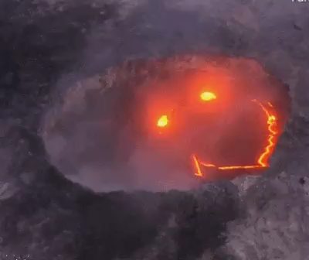
In this Lesson, you will learn about a wide range of hazards created by volcanoes. By the end you should be able to:
1. | Describe and identify hazards that are created by volcanoes;
2. | Compare the effects of two historic volcanic eruptions.

Slide 3
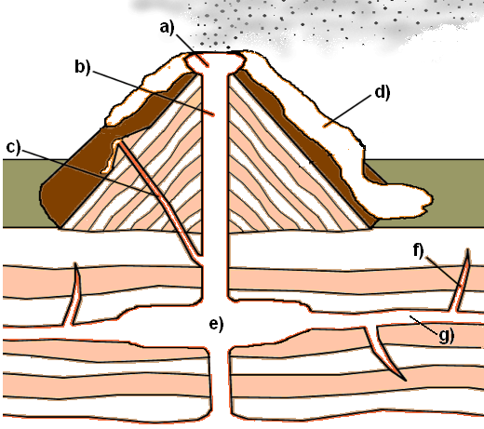
Parts of the Volcano
Crater
Main Vent
Side Vent
Lava
Magma Chamber
Dike
Sill

Slide 4
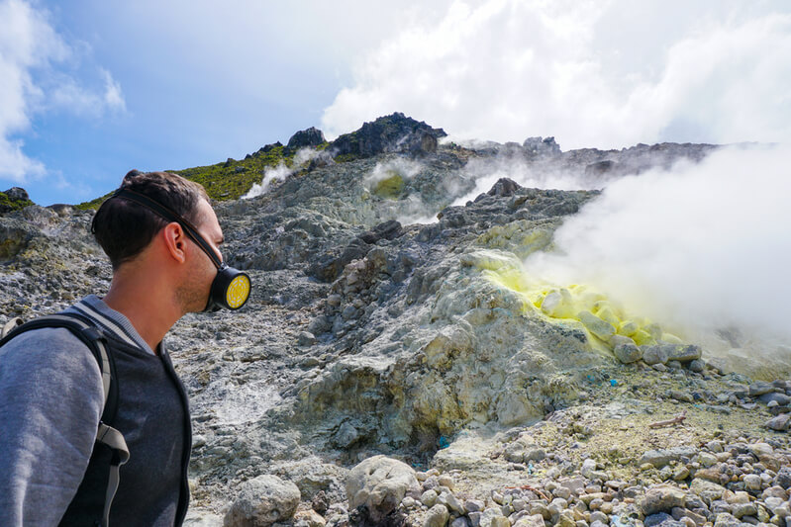
Volcanic Gases
Volcanoes expel several dangerous gases, including sulfur dioxide (SO₂​) and hydrogen sulfide (H₂​S). These gases are highly toxic, colourless and smell like rotten eggs!
People caught near an erupting volcano can wear gas masks and carry electronic monitors to protect themselves from dangerous gas levels.

Slide 5
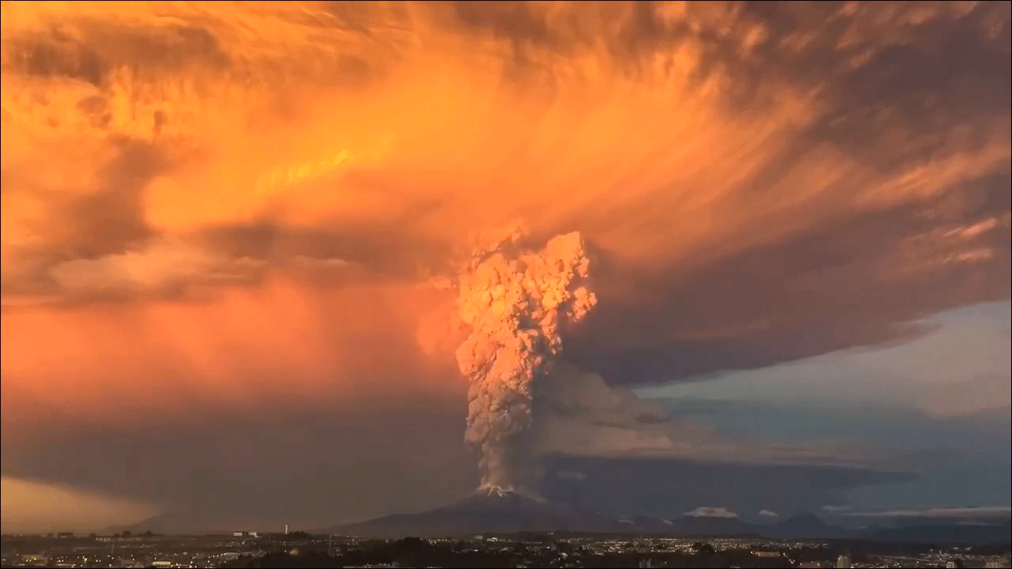
Ash Clouds
Massive plumes of ash cause a number of issues for people. Volcanic ash particles are essentially microscopic pieces of natural glass. If they enter a person's lungs they cause major breathing difficulties.
Ash can even wreck the engines of jet-powered aircraft! When Iceland's Eyjafjallajökull volcano erupted in 2010, an ash cloud over Europe caused the largest air traffic shut-down since World War II.

Slide 6
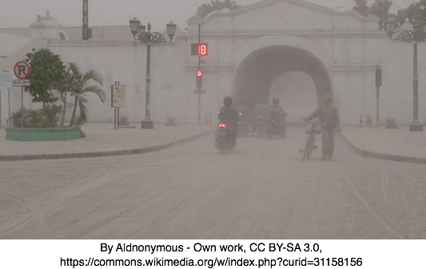
Ash Clouds
After being erupted, ash eventually falls back down and makes a blanket over the landscape. This can damage the environment in the short term by clogging rivers and burying plants.
However, it's not all bad news! Volcanic ash also adds nutrients to the soil, so it brings long-term benefits for crop plants and the people who eat them.

Slide 7

Lava Bombs
Lava is molten rock that gets flung out of a volcano during an eruption. It sometimes solidifies in mid-air to form 'bombs'. These are large fragments of rock at least 64 millimetres across.
Lava bombs often have unique teardrop shapes as a result of their flight through the air. Despite their name, they usually don't explode. However, their large size and weight means they can damage buildings and injure people close to the eruption.

Slide 8
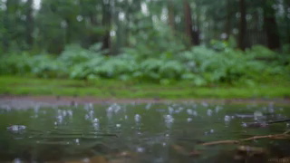
Acid Rain
When acidic gases such as hydrogen chloride (HCl) are emitted from an eruption, they enter the atmosphere and react with the water droplets inside clouds. Those droplets then fall as acid rain.
Acid rain is a problem because it pollutes waterways, kills vegetation and weathers stone structures. In most cases it isn't directly harmful to people and animals, despite what you may see on TV!

Slide 9
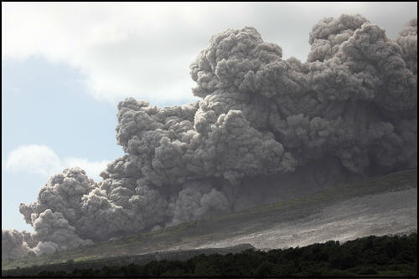
Pyroclastic Flows
Pyroclastic flows are yet another destructive force produced by volcanoes. They consist of hot gases and rock fragments (called tephra) moving at speeds of up to 700 kilometres per hour; that's over half the speed of sound!
The gas in a pyroclastic flow is heated to a searing 1000∘C. It burns and flattens everything in its path!

Slide 10
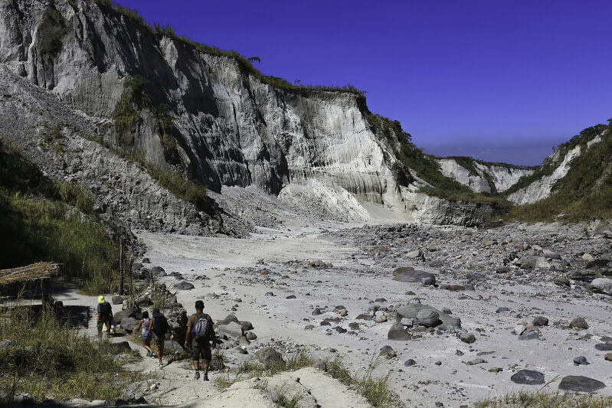
Lahars
Lahars are giant mud slides formed when material from a pyroclastic flow combines with water. This usually occurs in river valleys.
Lahars are incredibly dangerous because they can destroy almost anything in their path. In 1991, a colossal eruption at Mount Pinatubo created lahars up to 6 metres thick that buried buildings, rivers and farmland on the Philippine island of Luzon.

Slide 11
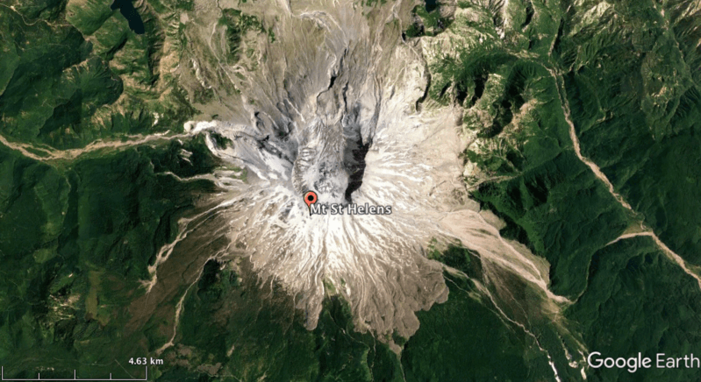
Volcanoes are majestic and exciting, but their eruptions can also be deadly.
The eruption of Mount St. Helens in 1980, for example, will always be remembered as one of the greatest tragedies in American history.
Mount St. Helens is located in Washington, one of the western United States of America. Even before 1980 this volcano was known for its explosions of ash and silica-rich rock domes. It was an impressive peak that inspired many Native American legends.

Slide 12
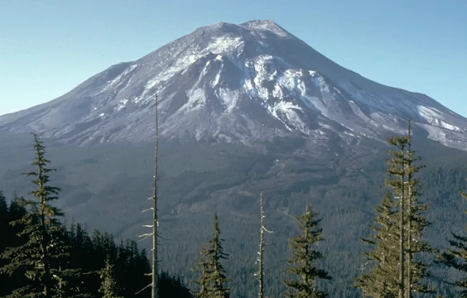
In the weeks before May 1980, geologists noticed that Mount St. Helens was getting bigger.
Molten rock was rising up from deep inside the Earth and filling up the volcano, causing its north face to bulge outward.
On May 18 the north face gave way in a gigantic landslide. As rock fell from the side of the volcano, the molten material inside burst free in a huge sideways explosion. This created a pyroclastic flow that overtook the original landslide and buried everything in its path.

Slide 13
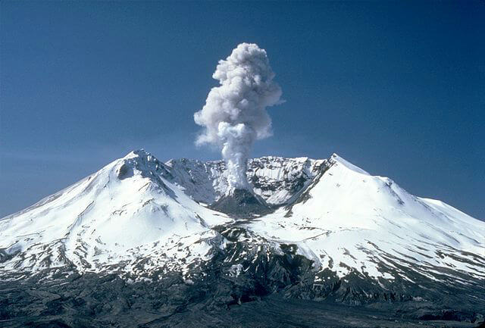
With 57 lives lost and scoring a 5 on the Volcanic Explosivity Index, this eruption was the deadliest in American history.
In addition to landslides and pyroclastic flows, Mount St. Helens also sent plumes of ash several kilometres into the sky. It even melted the ice and snow around its summit, which mixed with pyroclastic material to form destructive lahars.
The reason this eruption was so devastating was because most of its power was concentrated in a sideways blast from the north face. Very few people expected Mount St. Helens to erupt in this way.

Slide 14
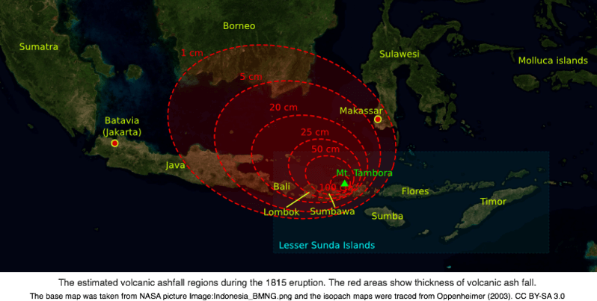
In April 1815, explosions at Mount Tambora literally sent shockwaves around the world!
Sounds from the eruption were heard in the furthest reaches of Indonesia, where people thought they were hearing gunshots. Within 1300 kilometres of the volcano, everything was covered in choking ash.
Pyroclastic flows completely flattened the village of Tambora, where 10,000 people lived. Overall, at least 71,000 people tragically lost their lives, making this the deadliest eruption in all of recorded history.

